Slide 1

Developing a pong game

Slide 2
Entity
Any game object, player, enemy, coin, bullet, wall, weapon, treasure box, bomb, etc, is an entity
Entity is a generic object; we need to add FXGL library components or customized components to each entity
Components handle what data each entity holds and define how an entity behaves

Slide 3
Methods to be Called on Entity
addComponent(Component c)
removeComponent(Component c)
setProperty(String key, Object value)
getComponents()
getPosition()/setPosition(Point2D p)
translate(Point2D p)
isVisible()/setVisible(boolean b)
getType()/setType(Object type)

Slide 4
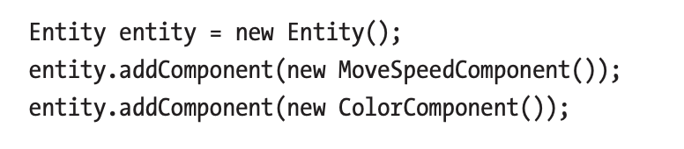
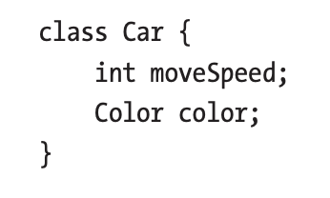
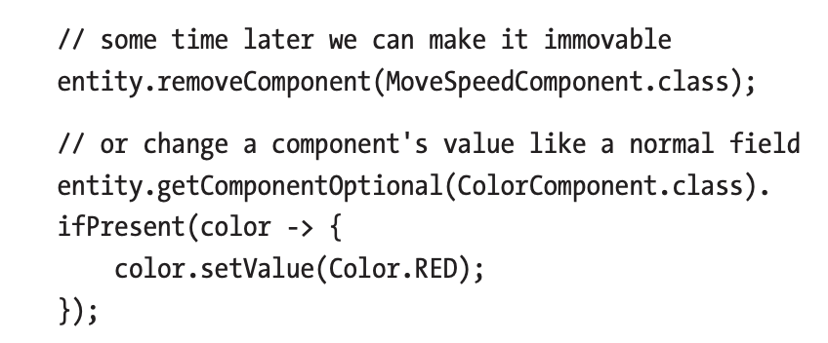
Components as Data

Slide 5
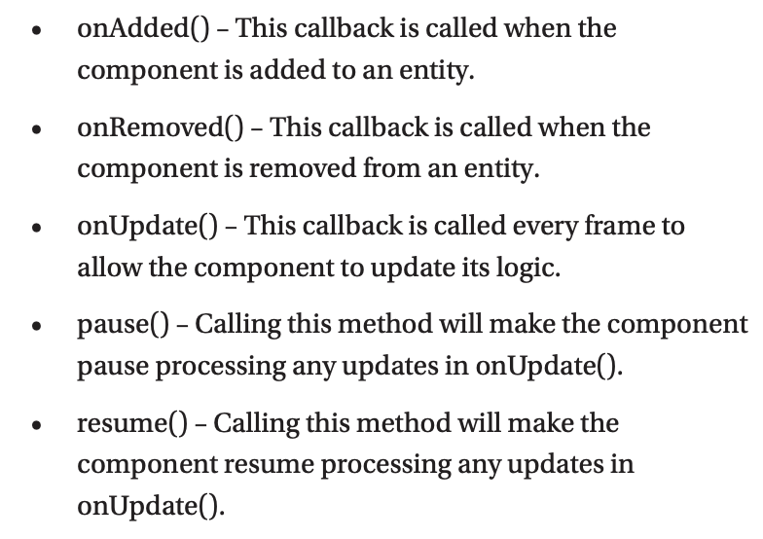
Components as Behaviour

Slide 6
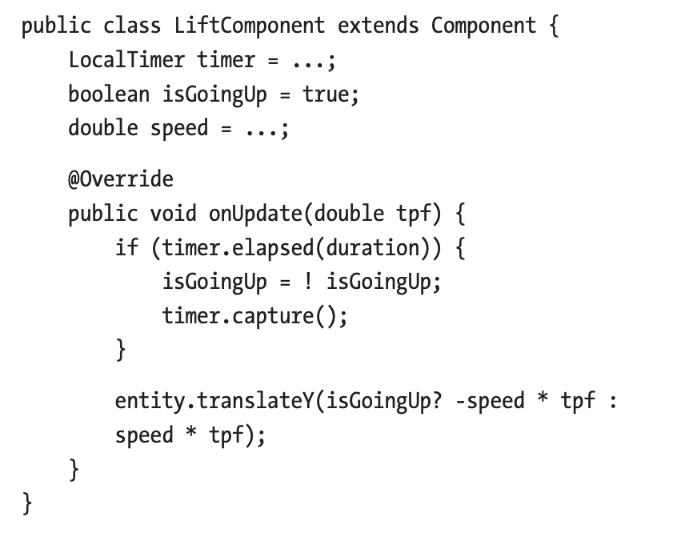

Slide 7
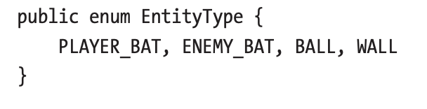
The Pong Game
Defining entities:
The player bat
The enemy bat
The ball
Walls

